Slide 1

InstantMesh Extended
Arizbeth Rojas & Emma Vejcik

Slide 2
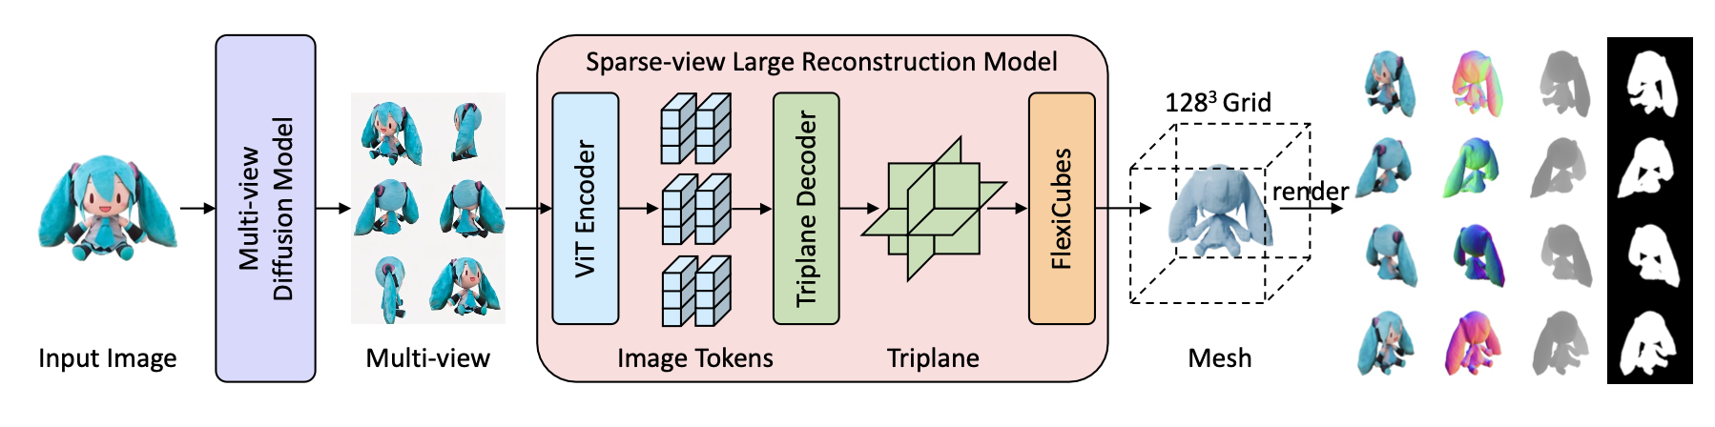

InstantMesh Review
Notes:
In our previous presentation, we presented InstantMesh as a proposed Generative 3D mesh model. InstantMesh takes a single image which is fed into a multi view diffusion model where the output is 6 different images of the initial image from specified differing viewpoints.
These images are then used as the input for a Sparse View Large Reconstruction model that uses a Visual Transformer to encode the multiview images into tokens and then decoded into a triplane representation from which we can interpret the resulting implicit surface with FlexiCubes to create a 3D explicit mesh.

Slide 3
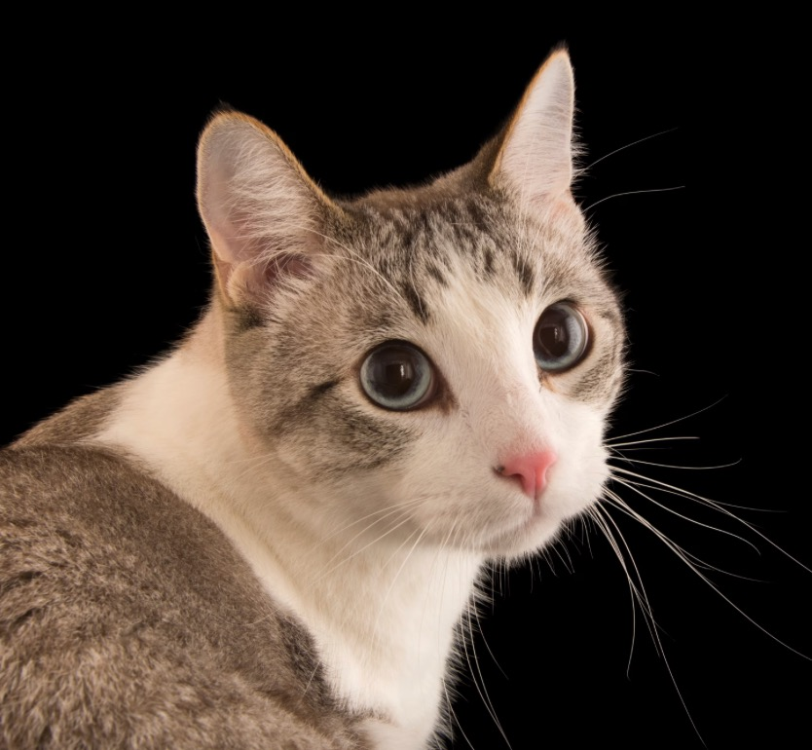
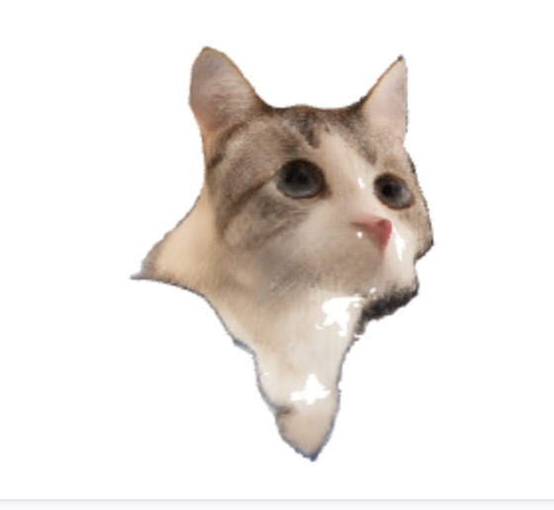
The Problem
Resolution
Tiny/Thin Details
Triplane decoder bottlenecks resolution by producing 64 x 64 triplanes
InstantMesh is less effective at handling delicate mesh details than NeRF models

Slide 4


Main Idea
By dedicating additional resources and time to the model when creating meshes that require finer details, we can obtain higher quality meshes while also remaining efficient with our delegation of computational resources.

Slide 5
Methods
01
02
03
04
Obtain measure of “detail” in processed image
Compare individual image to a set of images
Use metrics to adjust parameters of generated mesh
Generate mesh

Slide 6
Fast Fourier Analysis (for One Image)
We can obtain a metric of how “detailed” an image is by analyzing the “high-frequency” content in the image. High-frequency areas in image correspond to rapid intensity pixel changes, like edges or fine textures.
Implementing Fourier Analysis:
Convert Image to Grayscale (optional but common for frequency analysis).
Apply 2D Fast Fourier Transform (FFT): This transforms the image to the frequency domain, where each point represents a frequency component of the image.
Shift Zero Frequency to the Center: For visualization and easier filtering, shift the zero frequency component to the center.
Define a High-Frequency Region: High frequencies are typically in the outer areas of the Fourier-transformed image. We can define a "high-frequency mask" that isolates this region.
Calculate High-Frequency Content: Using the mask, compute a metric like the average or total magnitude of high-frequency components to quantify the high-frequency content.
Notes:
Fourier analysis converts an image to the frequency domain, highlighting areas of fine detail (high frequencies) and smooth regions (low frequencies). By isolating high-frequency components with a mask, we can quantify the amount of detail or texture in the image.

Slide 7
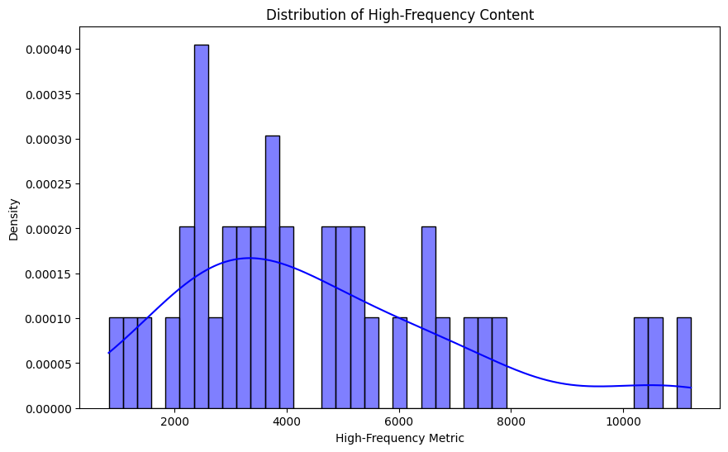
Fast Fourier Analysis (for Set of Images)
Apply Fourier Analysis to all images in given dataset: In order to conserve resources, we used the given subset of 41 images that the InstantMesh authors used to test their results.
Obtain the mean and standard deviation of dataset.
Determine distribution of dataset.

Slide 8
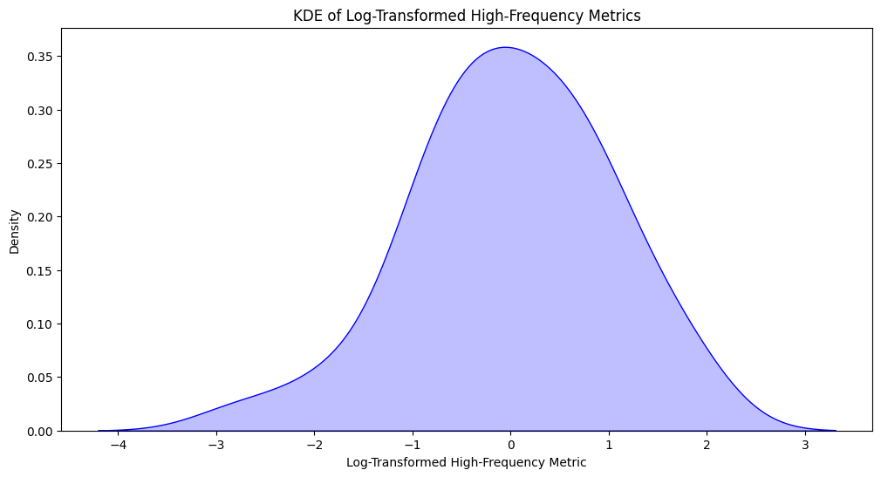
Distribution Analysis
In order to scale the number of iterations the model uses per image, we need to place the image’s high-frequency metric within the context of all the other images in the dataset.
Determine Distribution of High-Frequency Metric:
Plot Histogram: Reveals a right-skewing plot with a semi-normal shape.
Use QQ-Plot test, Shapiro-Wilks test to determine normality: We reject the null hypothesis of a normal distribution.
Normalize Data: Since the data appears to fall into the shape of a bell curve, we determined that a log transform would best suit our needs in this case. Then, we use z-score normalization to center data at 0 with an SD at 1.
Check Normalization: Data now appears to fall into a normal distribution.

Slide 9
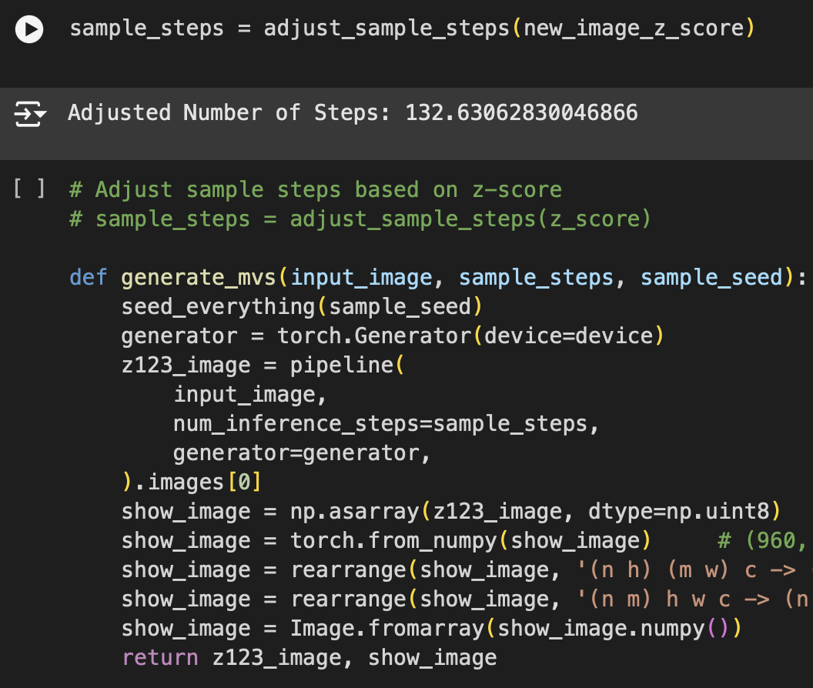
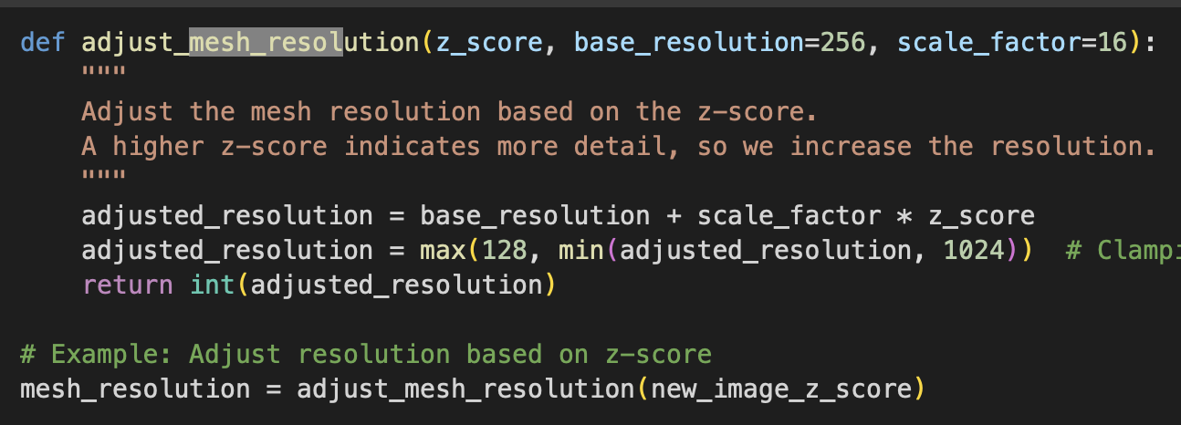
Modify Iterations by Z-Score
Use linear scale based on z-score: adjusted_steps = base_steps + scale*z_score
Update functions in model: sample_steps and mesh_resolution
Notes:
Where scale is a hyperparameter that we can tune to change the impact of the z-score.
sample_steps parameter directly impacts the number of inference steps used by the pipeline to generate the multi-view images (mv_images). Here’s how it affects the function:
Quality and Detail of Output:
Higher sample_steps generally lead to better quality images, as more steps allow the diffusion model to refine the image details incrementally. More steps reduce noise and add finer details, making the output sharper and closer to the original intent.
Increasing sample_steps will proportionally increase the time required to generate the images, as each step involves a computationally intensive pass through the model. For real-time or performance-sensitive applications, this can be an important trade-off, as setting sample_steps too high can make the process slow, especially on hardware with limited computational resources.
mesh_resolution parameter is used in the make_mesh function to control the resolution of the generated 3D mesh. Its significance lies in the following key aspects:
Mesh Detail:
Higher values for mesh_resolution allow for finer detail in the 3D mesh, creating a more accurate and visually detailed representation of the original image content. A lower mesh_resolution will generate a mesh with less detail, which might look blockier or rougher in comparison.
By dynamically adjusting the mesh_resolution based on z_score (computed from high-frequency metrics), the code tailors the resolution to the complexity of the input. For example, a high z_score (indicating more texture/detail) results in a higher mesh resolution to better capture those intricate features.

Slide 10
Results
Quantitative Metrics: get a sense of similarity and error levels between 2D images or views
SSIM (structural similarity)
PSNR (Peak Signal-to-Noise Ratio)
Mean Squared Error between images generated by original vs. altered codes
3D Mesh Comparisons: to measure the distance in shape and alignment between two meshes
Chamfer distance
Hausdorff distance
Parameter-Specific Impact:
Track and log the difference in processing time and memory usage to assess performance

Slide 11
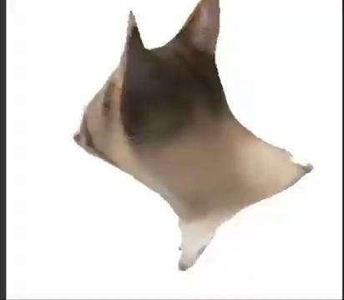
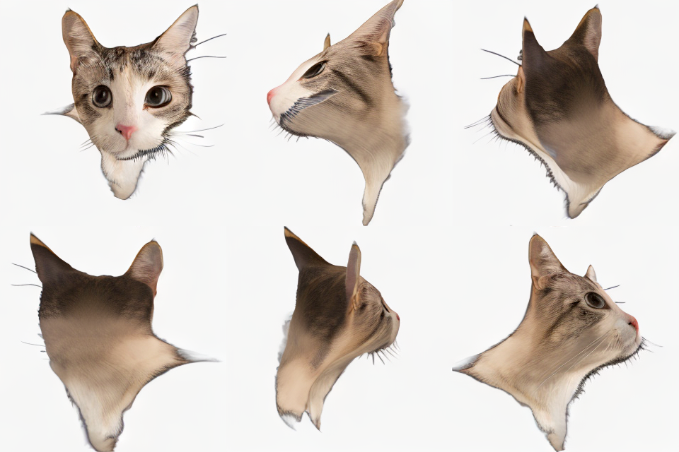
Results

Slide 12
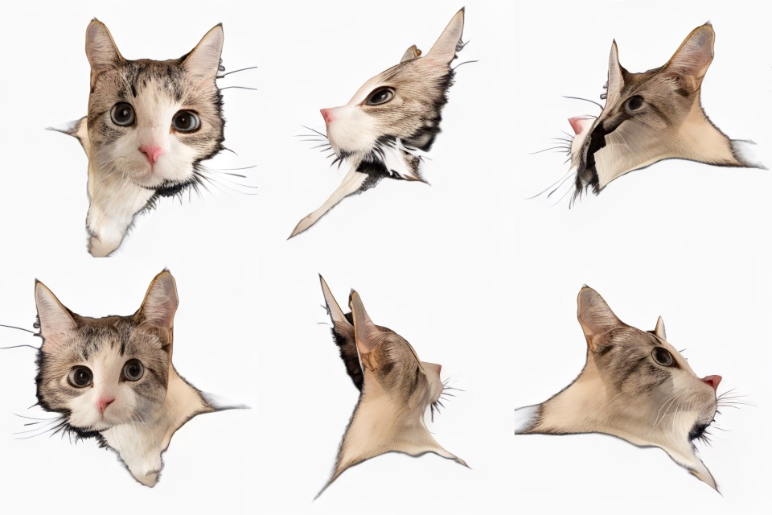
Results
Extended Model
Original Model

Slide 13
Novelty & Significance
Using a high-frequency metric to dynamically scale the number of sample steps in InstantMesh introduces a novel approach that allows the mesh generation process to adapt to the complexity of the underlying geometry. This extension has several significant impacts and benefits:
Adaptive Sampling Based on Detail Level: our algorithm can assess areas of the model with higher levels of detail to detect fine textures and intricate edges.
Efficient Allocation of Computational Resources: moves away from the "one-size-fits-all" approach of typical meshing algorithms, instead introducing a metric-driven, data-dependent sampling strategy.
Integration of Frequency Analysis with Geometric Meshing: the integration of Fourier Transforms and 3D Gen AI highlights how techniques from other domains (such as signal processing) can be innovatively applied to improve 3D mesh generation.
Notes:
Adaptive Sampling Based on Detail Level:
By introducing a high-frequency metric, the algorithm can assess areas of the model with high levels of detail (fine textures, intricate edges) versus simpler, low-frequency regions (flat surfaces, large shapes).
The novelty here is in adapting the sampling density to mesh complexity; areas with higher frequency would require more sample steps to capture details, while smoother areas need fewer, reducing unnecessary computation.
Efficient Allocation of Computational Resources:
Traditional meshing methods often apply a uniform sampling approach, resulting in wasted computation on low-detail regions. The high-frequency metric enables InstantMesh to allocate computational resources more intelligently, focusing on regions that truly benefit from increased sample steps.
This selective approach to sampling is novel because it moves away from the "one-size-fits-all" approach of typical meshing algorithms, instead introducing a metric-driven, data-dependent sampling strategy.
Integration of Frequency Analysis with Geometric Meshing:
Combining frequency analysis (often used in signal processing) with geometric meshing is a unique intersection. This technique leverages the high-frequency content to influence the meshing parameters, which is a relatively novel concept in adaptive meshing.
This integration highlights how techniques from other domains (such as image processing) can be innovatively applied to improve 3D mesh generation.

